Slide 1

Burmese
or®musrf;pm
tkwfNrpf
Texas jrdk.rS or®musrf;pm-tkwfjrpf (edkifiHwumtrSkawmfaqmifvkyfief;)
\ wifjycsuf
www.biblebasically.org
Dr ရက္ခ္ ဂရီဖိတ္၊ စကၤပူဓမၼေကာလိပ္ • www.BibleStudyDownloads.org

Slide 2


(tpDtpOfvdkufNyKpkxm;ygonf)
taNccHusus or®musrf;pm
®
tydkif; 7
usrf;pmtkyfrsm;udk tpDtpOfvdkufxm;Ncif;? "r®a[mif;usrf;\tpDtpOfvdkufwnfaqmufrI
©2004 TBBMI
8.0.07.02

Slide 3
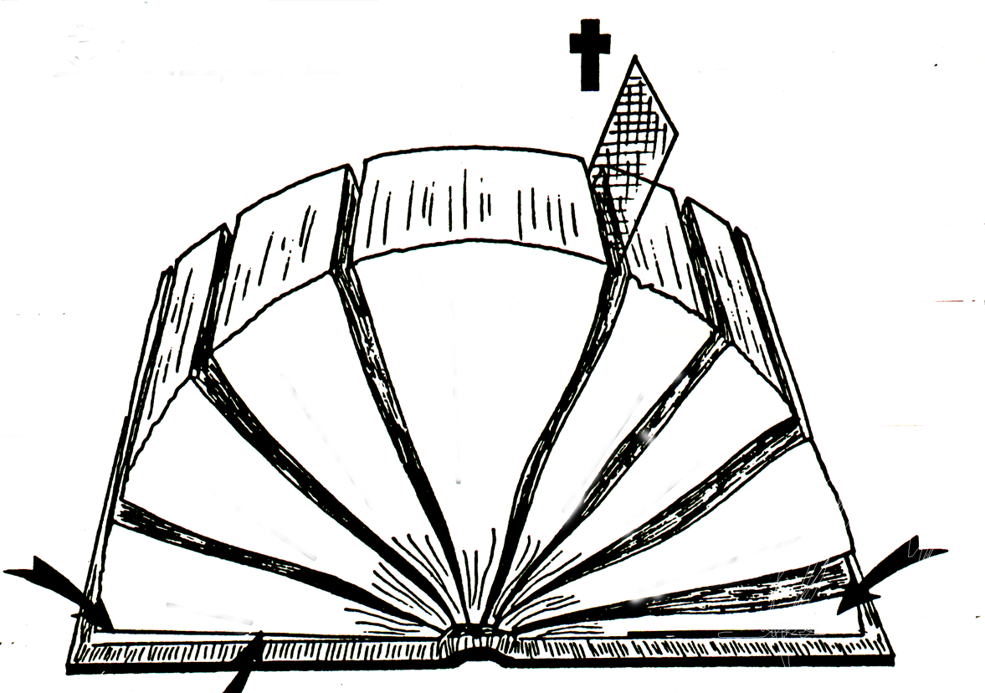
s
1600 ESpf
u
c
a&;om;ol 40 OD;
"r® opf
“ ”
“ ”
C(a[mif;)
"r®a[mif;
i(opf)
*
wckwnf;aomOD;wnfcsuf
bk&m;ocif\bkef;awmf
p(a[mif;)
39 tkyf
q(opf)
27 tkyf
a[NAJ
*&dwf
Z(a[mif;)
ps(opf)
4
3
5
n(a[mif;)
ynmwfawmf?*wdawmf
owif;aumif;
!(opf)
aus;Zl;awmf?NynfYpHkcsuf
ya&mzufusrf;
6
uAsmtvuømusrf;
2
wrefawmf
7
ordkif;usrf;
a&;pmapmifusrf;
1
ynwfusrf;
8
Asm'dwfusrf;
#(a[mif;)
a0;BunfYrSefaNymif;
a0;BunfYrSefaNymif;
rSefaNymif;
2 a0;BunfYrSefaNymif;
1 eD;BunfYrSefaNymif;
V(opf)
twdwfumv
P(a[mif;)
w
tem*wfumv
©2004 TBBMI
The “Opened” Bible
8.0.07.
03

Slide 4
4
3
5
6
2
tem*wådusrf;
uAsmusrf;
7
&mZ0ifusrf;
1
ydnwfwdusrf;
8
The “Opened” Bible
©2004 TBBMI
04
8.0.07.

Slide 5
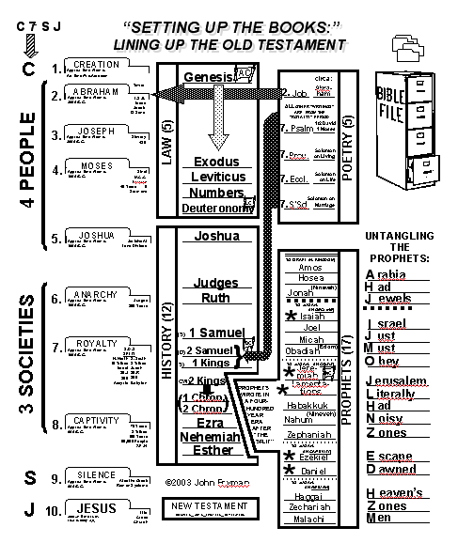
"r®a[mif;usrf;rsm;udk
tpDpOfwusxm;&ef
taxmuftulrsm;
oifaxmuful trSwf -19
05

Slide 6
a&TpOfrsKd;qufpm&if;rsm;
ydnwåd ESif. &mZ0ifusrf;rsm;
uAsm ESif. ya&mzufusrf;rsm;
rSwfOmPftaxmuftulNyKud7d,m
06

Slide 7
a&TpOfrsKd;qufpm&if;rsm;
ydnwåd ESif. &mZ0ifusrf;rsm;
uAsm ESif. ya&mzufusrf;rsm;
rSwfnmPftaxmuftulNyKud7d,m
07

Slide 8
a&TpOfrsKd;qufpm&if;rsm;
ydnwåd ESif. &mZ0ifusrf;rsm;
uAsm ESif. ya&mzufusrf;rsm;
rSwfnmPftaxmuftulNyKud7d,m
08

Slide 9
a&TpOfrsKd;qufpm&if;rsm;
ydnwåd ESif. &mZ0ifusrf;rsm;
uAsm ESif. ya&mzufusrf;rsm;
rSwfnmPftaxmuftulNyKud7d,m
09

Slide 10
a'gifvdkuf b,fbufodkYOD;wnfNyD;pOf;pm;yg
a&TpOfrsKd;qufpm&if;rsm;
ydnwåd ESif. &mZ0ifusrf;rsm;
uAsm ESif. ya&mzufusrf;rsm;
rSwfnmPftaxmuftulNyKud7d,m
10

Slide 11
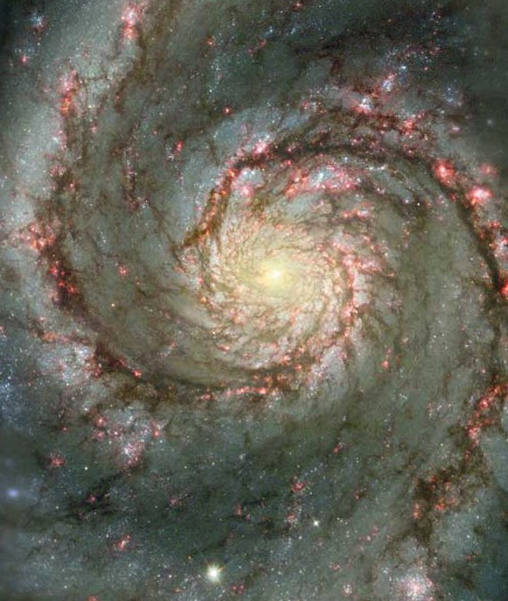
The Glory of God
"r®a[mif;usrf;jynf.pHkpGma&;jyDcsdef- ESpfaygif; 1500 cefU
TIME REQUIRED FOR WRITING: ABOUT 1,500 YEARS (OT)
1
11

Slide 12


REFER STUDY HELP #19
urÇmOD;usrf;
AC
ydnwådusrf; (5)
xGufajrmuf&musrf;
0wfjyK&musrf;
awmvnf&musrf;
w&m;a[m&musrf;
LC
12

Slide 13

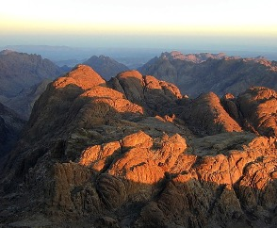
AC
pmtkyfrsm;udk tpDtpOfvdkufxm;Ncif;? "r®a[mif;usrf;\tpDtpOfvdkufwnfaqmufrIS
“”ydnmwådusrf;
5 tkyf
(odkY)
wl&usrf;
ydnwådusrf; (5)
usrf;pmumvcefYrSef;aNc?tNA[H rwdkifrSD bDpD 1400.
LC
1
13

Slide 14
pmtkyfrsm;udk tpDtpOfvdkufxm;Ncif;? "r®a[mif;usrf;\tpDtpOfvdkufwnfaqmufrIS
AC
ydnmwådusrf;
5 tkyf
(odkY)
wl&usrf;
ydnwådusrf; (5)
odkY
usrf;pmumvcefYrSef;aNc?tNA[H rwdkifrSD bDpD 1400
LC
14

Slide 15
pmtkyfrsm;udk tpDtpOfvdkufxm;Ncif;? "r®a[mif;usrf;\tpDtpOfvdkufwnfaqmufrIS
urÇmOD;usrf;
AC
ydnmwådusrf;
5 tkkyf
odkY
wl&usrf;
ydnwådusrf; (5)
usrf;pmumvcefYrSef;aNc?tNA[H rwdkifrSD bDpD 1400
LC
15

Slide 16
pmtkyfrsm;udk tpDtpOfvdkufxm;Ncif;? "r®a[mif;usrf;\tpDtpOfvdkufwnfaqmufrIS
urÇmOD;usrf;
AC
ydnmwådusrf;
5 tkkyf
odkY
wl&usrf;
ydnwådusrf; (5)
xGufaNrmuf&musrf;
usrf;pmumvcefYrSef;aNc?tNA[H rwdkifrSD bDpD 1400
LC
16

Slide 17
pmtkyfrsm;udk tpDtpOfvdkufxm;Ncif;? "r®a[mif;usrf;\tpDtpOfvdkufwnfaqmufrIS
urÇmOD;usrf;
AC
ydnmwådusrf;
5 tkkyf
odkY
wl&usrf;
ydnwådusrf; (5)
xGufaNrmuf
0wfNyK&musrf;
usrf;pmumvcefYrSef;aNc?tNA[H rwdkifrSD bDpD 1400
LC
17

Slide 18
pmtkyfrsm;udk tpDtpOfvdkufxm;Ncif;? "r®a[mif;usrf;\tpDtpOfvdkufwnfaqmufrIS
urÇmOD;usrf;
AC
ydnmwådusrf;
5 tkkyf
odkY
wl&usrf;
ydnwådusrf; (5)
xGufaNrmuf
0wfNyK&musrf;
awmvnf&musrf;
usrf;pmumvcefYrSef;aNc? tmNA[H rwdkifrSD bDpD 1400
LC
18

Slide 19
urÇmOD;usrf;
pmtkyfrsm;udk tpDtpOfvdkufxm;Ncif;? "r®a[mif;usrf;\tpDtpOfvdkufwnfaqmufrIS
AC
ydnmwådusrf;
5 tkkyf
odkY
wl&usrf;
ydnwådusrf; (5)
xGufaNrmuf
0wfNyK&musrf;
awmvnf&musrf;
usrf;pmumvcefYrSef;aNc?tNA[H rwdkifrSD bDpD 1400
w&m;a[m&musrf;
LC
19

Slide 20
pmtkyfrsm;udk tpDtpOfvdkufxm;Ncif;? "r®a[mif;usrf;\tpDtpOfvdkufwnfaqmufrIS
urÇmOD;usrf;
AC
ydnmwådusrf;
5 tkkyf
odkY
wl&usrf;
ydnwådusrf; (5)
xGufaNrmuf
0wfNyK&musrf;
awmvnf&musrf;
usrf;pmumvcefYrSef;aNc?tNA[H rwdkifrSD bDpD 1400
w&m;a[m&musrf;
LC
20

Slide 21

pmtkyfrsm;udk tpDtpOfvdkufxm;Ncif;? "r®a[mif;usrf;\tpDtpOfvdkufwnfaqmufrIS
urÇmOD;usrf;
AC
tmNA[Hy#dnmOf
urÇmOD; 12;1-3
ydnwådusrf; (5)
xGufaNrmuf
aNrydkifqkdifrIqdkif&m
y#dnmOf
w&m;a[m&musrf; 30;1-10
0wfNyK&musrf;
awmvnf&musrf;
w&m;a[m&musrf;
LC
2
21

Slide 22
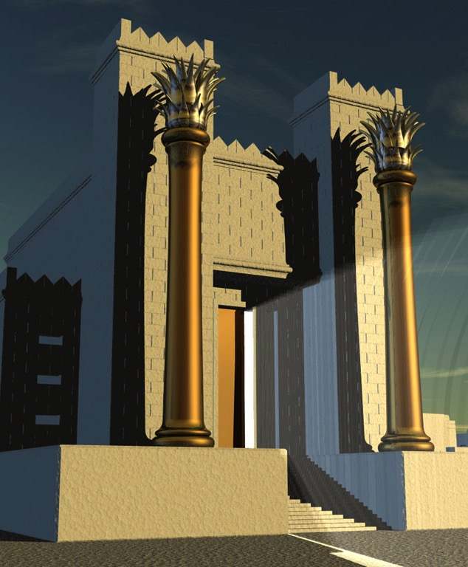
pmtkyfrsm;udk tpDtpOfvdkufxm;Ncif;? "r®a[mif;usrf;\tpDtpOfvdkufwnfaqmufrIS
pmtkyfrsm;udk
tpDpOfwusxm;Ncif;
(S)
&mZ0ifusrf; (12)
&mZ0ifusrf;ESif.oufqdkifaompmtkyf
DC
(D)
}
(S)
12 tkyf
(CW)
(
)
þoHk;oyfrIudkowdNyKyg!
2
22

Slide 23
a,m&I
pmtkyfrsm;udk tpDtpOfvdkufxm;Ncif;? "r®a[mif;usrf;\tpDtpOfvdkufwnfaqmufrIS
usrf;rsm;udk
tpDpOfwusxm;Ncif;
&mZ0ifusrf; (12)
(S)
&mZ0ifusrf;qdkif&m
DC
(D)
}
(S)
12 tkyf
(CW)
(
)
usrf;pmumvcefYrSef;aNc? bDpD 1400-1350
23

Slide 24
a,m&I
pmtkyfrsm;udk tpDtpOfvdkufxm;Ncif;? "r®a[mif;usrf;\tpDtpOfvdkufwnfaqmufrIS
w&m;olMuD;rsm;
usrf;rsm;udk
tpDpOfwusxm;Ncif;
&mZ0ifusrf; (12)
(S)
&mZ0ifusrf;qdkif&m
12 tkyf
DC
(D)
}
(S)
(CW)
(
)
usrf;pmumvcefYrSef;aNc? bDpD 1400 bDpD 1050 txd
24

Slide 25
a,m&I
pmtkyfrsm;udk tpDtpOfvdkufxm;Ncif;? "r®a[mif;usrf;\tpDtpOfvdkufwnfaqmufrIS
w&m;olMuD;rsm;
&ko
usrf;rsm;udk
tpDpOfwusxm;Ncif;
&mZ0ifusrf; (12)
(S)
&mZ0ifusrf;qdkif&m
DC
(D)
}
(S)
12 tkyf
(CW)
(
)
usrf;pmumvcefYrSef;aNc? bDpD 1100
25

Slide 26
a,m&I
pmtkyfrsm;udk tpDtpOfvdkufxm;Ncif;? "r®a[mif;usrf;\tpDtpOfvdkufwnfaqmufrIS
w&m;olMuD;rsm;
&ko
usrf;rsm;udk
tpDpOfwusxm;Ncif;
a&Smvk
‘'g0d'f
&mZ0ifusrf; (12)
(S)
a&Smvkrkef
&mZ0ifusrf;qdkif&m
DC
(D)
}
(S)
NynfwGif;ppf
12tkyf
(CW)
(
)
usrf;pmumvcefYrSef;aNc/ bDpD 1050 -600 txd
5
26

Slide 27
a,m&I
pmtkyfrsm;udk tpDtpOfvdkufxm;Ncif;? "r®a[mif;usrf;\tpDtpOfvdkufwnfaqmufrIS
w&m;olMuD;rsm;
&ko
usrf;rsm;udk
tpDpOfwusxm;Ncif;
1&mZ0if
&mZ0ifusrf; (12)
(S)
2&mZ0if
&mZ0ifusrf;qdkif&m
DC
(D)
}
(S)
12tkyf
(CW)
(
)
usrf;pmumvcefYrSef;aNc? bDpD 1050 -970 txd
27

Slide 28
a,m&I
pmtkyfrsm;udk tpDtpOfvdkufxm;Ncif;? "r®a[mif;usrf;\tpDtpOfvdkufwnfaqmufrIS
w&m;olMuD;rsm;
&ko
usrf;rsm;udk
tpDpOfwusxm;Ncif;
1&mZ0if
&mZ0ifusrf; (12)
(S)
&mZ0ifusrf;qdkif&m
2&mZ0if
DC
(D)
}
3&mZ0if
(S)
4&mZ0if
12tkyf
(CW)
(
)
usrf;pmumvcefYrSef;aNc? bDpD 970-600 xd
28

Slide 29
a,m&I
pmtkyfrsm;udk tpDtpOfvdkufxm;Ncif;? "r®a[mif;usrf;\tpDtpOfvdkufwnfaqmufrIS
w&m;olMuD;rsm;
&ko
usrf;rsm;udk
tpDpOfwusxm;Ncif;
1&mZ0if
&mZ0ifusrf; (12)
(S)
&mZ0ifusrf;qdkif&m
2&mZ0if
DC
(D)
}
3&mZ0if
(S)
4&mZ0if
12tkyf
(CW)
(
)
usrf;pmumvcefYrSef;aNc? bDpD 1050 -600 xd
29

Slide 30
(&)
(')
(&)
(ywp
a,m&I
pmtkyfrsm;udk tpDtpOfvdkufxm;Ncif;? "r®a[mif;usrf;\tpDtpOfvdkufwnfaqmufrIS
a&Smvk
w&m;olMuD;rsm;
&ko
usrf;rsm;udk
tpDpOfwusxm;Ncif;
'g0d'f
1&mZ0if
&mZ0ifusrf; (12)
(S)
&mZ0ifusrf;qdkif&m
2&mZ0if
DC
(D)
}
(S)
3&mZ0if
a&Smvkrkef
12tkyf
(CW)
4&mZ0if
(
)
NynfwGif;ppf
usrf;pmumvcefYrSef;aNc? bDpD 1050 -600 xd
30

Slide 31
pmtkyfrsm;udk tpDtpOfvdkufxm;Ncif;? "r®a[mif;usrf;\tpDtpOfvdkufwnfaqmufrIS
2&mZ0if
3&mZ0if
'g0d'f
'
a&mvkrkef
1&mZ0if
&
a&Smvk
usrf;rsm;udk
tpDpOfwusxm;Ncif;
&
2&mZ0if
NynfwGif;ppf
ywp
&mZ0ifusrf;qdkif&m
12tkyf
usrf;pmumvcefYrSef;aNc? bDpD 1050 -600 xd
14
31

Slide 32
pmtkyfrsm;udk tpDtpOfvdkufxm;Ncif;? "r®a[mif;usrf;\tpDtpOfvdkufwnfaqmufrIS
2&mZ0if
3&mZ0if
'g0d'f
'
a&Smvkrkef
1&mZ0if
&
a&Svk
usrf;rsm;udk
tpDpOfwusxm;Ncif;
&
4&mZ0if
NynfwGif;ppf
ywp
&mZ0ifusrf;qdkif&m
12tkyf
usrf;pmumvcefYrSef;aNc? bDpD 1050 -600 xd
5
32

Slide 33
a,m&I
pmtkyfrsm;udk tpDtpOfvdkufxm;Ncif;? "r®a[mif;usrf;\tpDtpOfvdkufwnfaqmufrIS
w&m;olMuD;rsm;
&ko
usrf;rsm;udk
tpDpOfwusxm;Ncif;
'g0dESif.qdkifaomy#dnmOf
2&m 7;16
1&mZ0if
&mZ0ifusrf; (12)
(S)
2&mZ0if
DC
(D)
}
(S)
3&mZ0if
(CW)
4&mZ0if
(
)
usrf;pmumvcefYrSef;aNc? bDpD 1000 xd
1
33

Slide 34
a,m&I
pmtkyfrsm;udk tpDtpOfvdkufxm;Ncif;? "r®a[mif;usrf;\tpDtpOfvdkufwnfaqmufrIS
w&m;olMuD;rsm;
&ko
usrf;rsm;udk
tpDpOfwusxm;Ncif;
1&mZ0if
&mZ0ifusrf; (12)
(S)
2&mZ0if
DC
&mZ0ifusrf;qdkif&m
12tkyf
(D)
}
(S)
3&mZ0if
(CW)
4&mZ0if
(
)
usrf;pmumvcefYrSef;aNc? bDpD 970 550 xd
1
34

Slide 35
a,m&I
pmtkyfrsm;udk tpDtpOfvdkufxm;Ncif;? "r®a[mif;usrf;\tpDtpOfvdkufwnfaqmufrIS
w&m;olMuD;rsm;
&ko
usrf;rsm;udk
tpDpOfwusxm;Ncif;
1&mZ0if
&mZ0ifusrf; (12)
(S)
4&mZ0if
2&mZ0if
DC
(D)
}
(S)
3&mZ0if
(CW)
4&mZ0if
1-2 &mZ0ifcsKyf
(
1&mcsKyf
)
a,bk,swlnDaom t&m...
2&mcsKyf
usrf;pmumvcefYrSef;aNc? bDpD 970 550 xd
2
35

Slide 36
a,m&I
pmtkyfrsm;udk tpDtpOfvdkufxm;Ncif;? "r®a[mif;usrf;\tpDtpOfvdkufwnfaqmufrIS
w&m;olMuD;rsm;
&ko
usrf;rsm;udk
tpDpOfwusxm;Ncif;
1&mZ0if
&mZ0ifusrf; (12)
(S)
ya&mzufESif.qdkifaomtNrif
pdwf0ifpm;bG,f&mpum;pk
2&mZ0if
DC
(D)
}
(S)
3&mZ0if
wlnDaomumv
(CW)
4&mZ0if
wlnDaomNzpf&yfrsm;
(
1&mcsKyf
)
wlnDaomusrf;ydk'f
2&mcsKyf
,Zfya&m[dwfESif.qdkifaomtNrif
usrf;pmumvcefYrSef;aNc? bDpD 970 550 xd
4
36

Slide 37
a,m&I
pmtkyfrsm;udk tpDtpOfvdkufxm;Ncif;? "r®a[mif;usrf;\tpDtpOfvdkufwnfaqmufrIS
w&m;olMuD;rsm;
usrf;rsm;udktpDpOf
vdkufpDjcif;
&ko
edkifiHESpfNcrf;uGJNcif;
pkpnf;aeaomekdifiHrS
ESpfedkifiHtNzpf
uGJoGm;Ncif;
1&mZ0if
&mZ0ifusrf; (12)
(S)
ordkif;
12 tkyfaomusrf;pm
2&mZ0if
DC
(D)
}
(S)
3&mZ0if
(CW)
4&mZ0if
(
1&mcsKyf
)
2&mcsKyf
tjzpfedkifqHk;cef.rSef;edkifaom ordkifaBumif;tcsdef (1050 bDpD 550 bDpD xd).
1
37

Slide 38
a,m&I
pmtkyfrsm;udk tpDtpOfvdkufxm;Ncif;? "r®a[mif;usrf;\tpDtpOfvdkufwnfaqmufrIS
w&m;olMuD;rsm;
&ko
usrf;rsm;udk
tpDpOfwusxm;Ncif;
1&mZ0if
&mZ0ifusrf; (12)
(S)
&mZ0ifusrf;qdkif&m
2&mZ0if
DC
(D)
}
(S)
3&mZ0if
12tkyf
(CW)
4&mZ0if
(
1&mcsKyf
)
2&mcsKyf
{Z&m
usrf;pmumvcefYrSef;aNc? bDpD 550 -450 xd
1
38

Slide 39
a,m&I
pmtkyfrsm;udk tpDtpOfvdkufxm;Ncif;? "r®a[mif;usrf;\tpDtpOfvdkufwnfaqmufrIS
w&m;olMuD;rsm;
&ko
usrf;rsm;udk
tpDpOfwusxm;Ncif;
1&mZ0if
&mZ0ifusrf; (12)
(S)
&mZ0ifusrf;qdkif&m
2&mZ0if
DC
(D)
}
(S)
3&mZ0if
12tkyf
(CW)
4&mZ0if
(
1&mcsKyf
)
2&mcsKyf
{Z&m
usrf;pmumvcefYrSef;aNc? bDpD 450
ae[rd
39

Slide 40
a,m&I
pmtkyfrsm;udk tpDtpOfvdkufxm;Ncif;? "r®a[mif;usrf;\tpDtpOfvdkufwnfaqmufrIS
w&m;olMuD;rsm;
&ko
usrf;rsm;udk
tpDpOfwusxm;Ncif;
1&mZ0if
&mZ0ifusrf; (12)
(S)
&mZ0ifusrf;qdkif&m
2&mZ0if
DC
(D)
}
(S)
3&mZ0if
12tkyf
(CW)
4&mZ0if
(
1&mcsKyf
)
2&mcsKyf
{Z&m
usrf;pmumvcefYrSef;aNc? bDpD 480
ae[rd
{owm
40

Slide 41
a,m&I
pmtkyfrsm;udk tpDtpOfvdkufxm;Ncif;? "r®a[mif;usrf;\tpDtpOfvdkufwnfaqmufrIS
w&m;olMuD;rsm;
&ko
usrf;rsm;udk
tpDpOfwusxm;Ncif;
1&mZ0if
&mZ0ifusrf; (12)
(S)
&mZ0ifusrf;qdkif&m
2&mZ0if
DC
(D)
}
3&mZ0if
(S)
12tkyf
(CW)
4&mZ0if
(
1&mcsKyf
)
2&mcsKyf
{Z&m
usrf;pmumvcefYrSef;aNc? bDpD 1400-440 xd
ae[rd
{owm
41

Slide 42
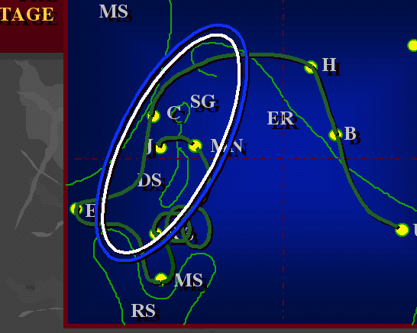
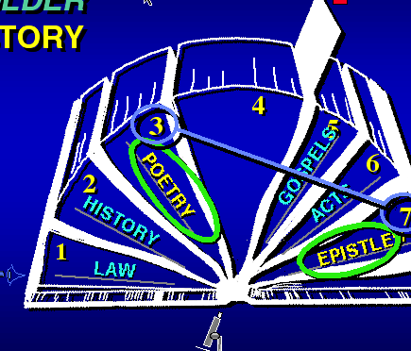
tpOfvdkufxm;&SdNcif;
ynwÅdusrf; ESif. &mZ0ifusrf;
uAsmtvuømusrf;ESif.
ya&mzufusrf;rsm;
rSwf&efenf;vrf;
42
4

Slide 43
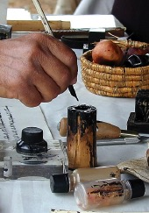
pmtkyfrsm;udk tpDtpOfvdkufxm;Ncif;? "r®a[mif;usrf;\tpDtpOfvdkufwnfaqmufrIS
CIRCA:
2.
a,mb
tmNA[H
tNcm;
usrf;rsm;
“uAsmusrf;”
tmNA[H
“uAsmusrf;”
a,mb
CIRCA:
tpNyK&m
“ bk&ifacwf ”
7.
uAsmusrf; (5) usrf;
“a,mb0w¦K” udkbk&ifacwfrwdkifrSDumv
wGif a7;om;ygonf/
7.
7.
7.
43
4
43

Slide 44
pmtkyfrsm;udk tpDtpOfvdkufxm;Ncif;? "r®a[mif;usrf;\tpDtpOfvdkufwnfaqmufrIS
CIRCA:
2.
a,mb
tmNA-
[H
“ uAsm ”
tNcm;
usrf;rsm;
“ uASmqdkif&musrf;sm;onf”
tmNA[H
CIRCA:
a,mb
“ bk&ifacwfrSpwifonf”
7.
uAsmusrf; (5) usrf;
7.
pkaygif;í
“uAsmqdkif&musrf;pmrsm;onf”
“bk&ifacwf” rSpwifygonf
7.
7.
.
44

Slide 45

pmtkyfrsm;udk tpDtpOfvdkufxm;Ncif;? "r®a[mif;usrf;\tpDtpOfvdkufwnfaqmufrIS
a,m&I
h)
(r)
TO ISRAEL (N. KINGDOM)
w&m;olBuD;rsm;
tmrkwf
“ uAsm”
a[ma&S
&ko
a,me
(w)
tmNA[H
*
CIRCA:
TO JUDAH: (IN DECLINE)
a,mb
&mZ0ifusrf; (12)
a[&Sm,
1&m
a,mv
(S)
}
rdu©m
2&m
DC
{'kH
(D)
BoA'H
3&m
*
(w)
(S)
TO JUDAH: (IN CRISIS)
a,&rd
NC
4&m
ALL OTHER
“WRITINGS” ARE
FROM THE
“ROYALTY” PERIOD
(CW)
PROPHETS WROTE IN A FOUR- HUNDRED YEAR ERA AFTER “THE SPLIT”
Nrnfwrf;pum;
( )
1&mcsKyf
[AuúKyf
2&mcskyf
em[kef
edea0
{Z&
pkaygif;í
“uAsmqdkif&musrf;pmrsm;onf”
“bk&ifacwf”” rSpwifygonf
ae[rd
aZzed
*
(w)
{owm
TO JUDAH: (IN CAPTIVITY)
a,Za*sv
*
'Ha,v
TO JUDAH: (IN RETURN)
(w)
[*¾J
Zmc&d
rmvcd
45

Slide 46
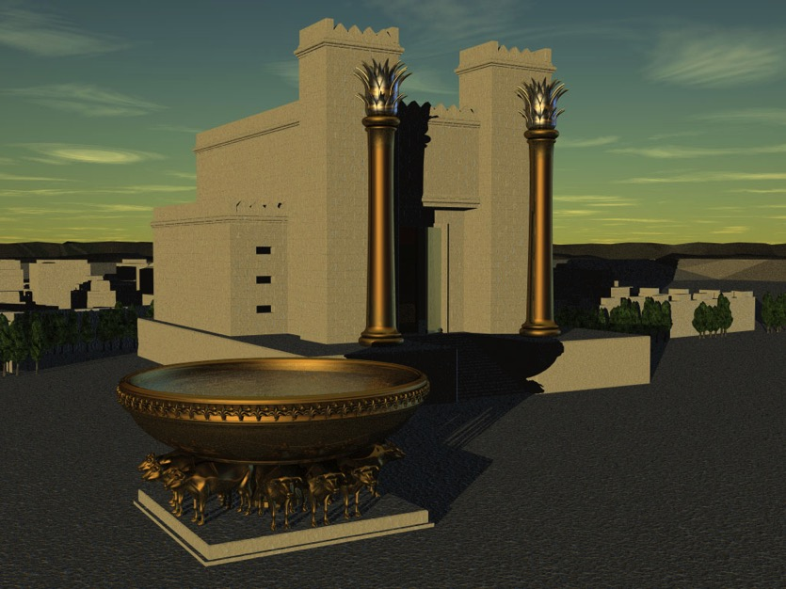
pmtkyfrsm;udk tpDtpOfvdkufxm;Ncif;? "r®a[mif;usrf;\tpDtpOfvdkufwnfaqmufrIS
CIRCA:
1.
a,mb
tmNA[H
“uAsmusrf;”
tNcm;
usrf;rsm;
“uAsmusrf;rsm;tpNyK&m”
tmNA[H
CIRCA:
tcsdefonf
a,mb
“bk7ifacwf”
7.
qmvH
1/2 'g0d
1 arma&S
1/2 'g0d'f
1 arma&S
uAsmusrf; (5) usrf;
qmvH
7.
7.
7.
46
1

Slide 47
pmtkyfrsm;udk tpDtpOfvdkufxm;Ncif;? "r®a[mif;usrf;\tpDtpOfvdkufwnfaqmufrIS
CIRCA:
2.
a,mb
tmNA[H
“uAsmusrf;”
tNcm;
usrf;rsm;
“uAsmusrf;rsm;tpNyK&m” tcsdefonf
tmNA[H
CIRCA:
a,mb
“bk7ifacwf”
7.
qmvH
1/2 'g0d
1 arma&S
1/2 'g0d'f
1 arma&S
uAsmusrf; ( 5)
qmvH
7.
okwåH
a&Smvkrdef
touf7Sifcsdef
a&Svkrkeftouf
&SSifcsdef
okwåH
7.
7.
47

Slide 48

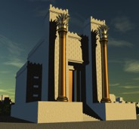
pmtkyfrsm;udk tpDtpOfvdkufxm;Ncif;? "r®a[mif;usrf;\tpDtpOfvdkufwnfaqmufrIS
CIRCA:
2.
a,mb
tmNA[H
“uAsmusrf;”
tNcm;
usrf;rsm;
“uAsmusrf;tpNyK&m”
oHvGif awmif
tmNA[H
CIRCA:
tcsdefonf
a,mb
“bk&ifacwf” Nzpfonf
7.
qmvH
1/2 'g0d
1 arma&S
1/2 'g0'f
1 arma&S
uAsmusrf; ( 5)
qmvH
a&Svkrkef
touf&Sifcsdef
Adr®mefawmfukef;
7.
okwåH
a&Smvkrkef
touf&Sifcsdef
okwåH
7.
a'oem
a&Svkrkef
touf&Sifcsdef
a&Smvkrkef
touf&Sifcsdef
a'oem
7.
48
1

Slide 49
pmtkyfrsm;udk tpDtpOfvdkufxm;Ncif;? "r®a[mif;usrf;\tpDtpOfvdkufwnfaqmufrIS
CIRCA:
2.
a,mb
tmNA[H
-
“uAsmusrf;”
tNcm;
usrf;rsm;
“uAsmusrf;tpNyK7m ”
CIRCA:
tcsdefonf
a,mb
tmNA[H
“bk&ifacwfNzpfonf”
7.
qmvH
1/2 'g0d
1 arma&S
1/2 'g0d'f
1 arma&S
uAsmusrf; ( 5)
qmvH
7.
okwÅH
a&Svkrkef
touf&Sifcsdef
a&Smvkrkef
touf&Sifcsdef
okwåH
7.
a'oem
a&Svkrkef
touf&Sifcsdef
a&Smvkrkef
touf&Sifcsdef
a&Smvkrkef
oDcsif;
tdrfaxmifNyKNyD;
a'oem
7.
a&Smvkrkef
a&SvkrkefoDcsif;
a&SmvkrkeftdrfaxmifNyKNyD;
49

Slide 50
pmtkyfrsm;udk tpDtpOfvdkufxm;Ncif;? "r®a[mif;usrf;\tpDtpOfvdkufwnfaqmufrIS
CIRCA:
2.
a,mb
tmNA[H
“uAsmusrf;”
tNcm;
usrf;rsm;
“uAsmusrf;tpNyK&m”
tmNA[H
CIRCA:
tcsdefonf
a,mb
“bk&ifacwfNzpfonf
7.
qmvH
1/2 'g0d
1 arma&S
1/2 'g0d'f
1 arma&S
uAsmusrf; ( 5)
qmvH
7.
okkwåH
a&Svkrkeftouf
&Sifcsdef
a&Smvkrkef
touf&Sifcsdef
a&Svkrkeftouf
&Sifcsdef
okwåH
7.
a'oem
a&Smvkrkef
touf&Sifcsdef
a&Smvkrkef
oDcsif;
a'oem
7.
tdrfaxmifNyKNyD
a&SmvkrkefoDcsif;
a&Smvkrkeftdrfaxmif
NyKNyD;
50

Slide 51
s
pmtkyfrsm;udk tpDtpOfvdkufxm;Ncif;? "r®a[mif;usrf;\tpDtpOfvdkufwnfaqmufrIS
a,mb
CIRCA:
2.
a,mb
tmNA[H
“uAsmusrf;”
tNcm;
usrf;rsm;
qmvH
“WRITINGS” ARE
“WRITINGS” ARE
tmNA[H
CIRCA:
FROM THE
a,mb
FROM THE
“ROYALTY” PERIOD
“ROYALTY” PERIOD
7.
qmvH
1/2 'g0d
1/2'g0d'f
1 arma&S
1 Moses
uAsmusrf; ( 5)
qmvH
okwåH
7.
okwåH
Solomon
on living
a&Smvkrkef
touf&Sifcsdef
a&Svkrkef
touf&Sifcsdef
okwåH
7.
a'oem
a&Smvkrkef
touf&Sifcsdef
a'oemusrf;
a'oem
7.
a&Smvkrkef
oDcsif;
tdrfaxmifNyKNyD;
a&Smvkrkef
oDcsif;
a&SmvkrkefoDcsif;
a&SmvkrkeftdrfaxmifNyKNyD;
51

Slide 52
txl;aus;Zl;
wifygw,f ...
tckxdkya&mzufawGeJYbmvkyf& rSmvJ?
'gayrJ....'gawGtm;vkH;
udk toif;tkyfq&m
ubJvkyfygap
©2004 TBBMI
1
8.0.07.
52

Slide 53

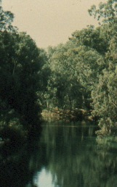

pmtkyfrsm;udk tpDtpOfvdkufxm;Ncif;? "r®a[mif;usrf;\tpDtpOfvdkufwnfaqmufrIS
(r)
(w)
“ya&mzufusrf;”
*
1&mZ0if
17 usrf;udk
(S)
(D)
2&mZ0if
}
(S)
3&mZ0if
ya&mzufusrf; (17)
4&mZ0if
(w)
NyifqifNcif;
(CW)
*
NC
(
1&mcsKyf
)
yYa&mzufrsm;u
uGJNym;NyD;
*
2&mcsKyf
ESpfaygif; 400
þoHl;oyfrIudkowdNyKyg!
aemufydkif;
uwnf;u
{Z&m
yif
a&;om;
ae[rd
Buyg
onf
.
(w)
{owm
*
*
(w)
usrf;pmumvcefYrSef;aNc?bDpD840 rS 430 xd
1
53

Slide 54
pmtkyfrsm;udk tpDtpOfvdkufxm;Ncif;? "r®a[mif;usrf;\tpDtpOfvdkufwnfaqmufrIS
(r)
(w)
““ya&mzufusrf;”
ya&mzufrsm;onf eKdifiH “ESpfNcrf;” uGJNyD; ESpfaygif; 400 cefYua&;om;cJhBuonf
*
(S)
1&mZ0if
17 usrf;udk
(D)
2&mZ0if
}
(S)
3&mZ0if
PROPHETS (17)
4&m
(w)
(CW)
*
NC
NyifqifNcif;
(
1&mcsKyf
)
PROPHETS
*
WROTE
2&mcsKyf
ACROSS
þoyfudkowd NyKyg!
FOUR
HUNDRED
{Z&m
YEARS
AFTER
ae[rd
“ THE
SPLIT”
.
(w)
{owm
*
*
(w)
usrf;pmumvcefYrSef;aNc?bDpD760 rS 430 xd
54

Slide 55
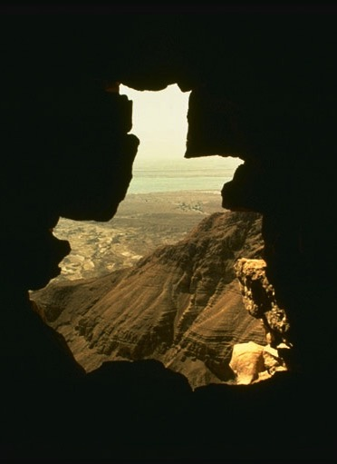
pmtkyfrsm;udk tpDtpOfvdkufxm;Ncif;? "r®a[mif;usrf;\tpDtpOfvdkufwnfaqmufrIS
(r)
(w)
ya&mzufrsm;onf or®musrf;pmtprSonf tqkH;wdkifatmif
txyfxyftcgcg
yg0ifae&kHrQomr[kwfyg
*
1&mZ0if
(S)
(D)
2&mZ0if
}
(S)
3&mZ0if
ya&mzufusrf; (17)
4&mZ0if
(w)
(CW)
*
NC
(
1&mcsKyf
)
PROPHETS
*
WROTE
2&mcsKyf
ACROSS
FOUR
HUNDRED
{Z&m
YEARS
AFTER
ae[rd
“ THE
SPLIT”
.
(w)
{owm
*
*
(w)
usrf;pmumvcefYrSef;aNc? bDpD760 rS 430 xd
55

Slide 56
pmtkyfrsm;udk tpDtpOfvdkufxm;Ncif;? "r®a[mif;usrf;\tpDtpOfvdkufwnfaqmufrIS
(r)
NyoemESpfck...
(w)
*
(S)
1&mZ0if
Nyoem #1 tpOfvdkufrusNcif;
(D)
2&mZ0if
}
(S)
3&mZ0if
ya&mzufusrf; (17)
4&mZ0if
(w)
(CW)
*
NC
(
1&mcsKyf
)
PROPHETS
*
WROTE
2&mcsKyf
ACROSS
ya&mzufBuD;rsm; ya&mzufi,fav;rsm;[kom
a,bk,scGJNcm;xm;cJhygonf
FOUR
HUNDRED
{Z&m
YEARS
AFTER
ae[rd
“ THE
SPLIT”
.
(w)
{owm
*
*
(w)
2
56

Slide 57
pmtkyfrsm;udk tpDtpOfvdkufxm;Ncif;? "r®a[mif;usrf;\tpDtpOfvdkufwnfaqmufrIS
(r)
(Oyrm-a[&Sm,)
(w)
ya&mzufBuD;rsm;-pmtrsm;tjym;
a&;om;olrsm;
*
(S)
1&mZ0if
(D)
2&mZ0if
}
(S)
3&mZ0if
ya&mzufusrf; (17)
(w)
(Oyrm-a,me)
(CW)
4&mZ0if
*
(
)
NC
1&mcsKyf
PROPHETS
*
ya&mzufi,fav;rsm;-pmtenf;i,fav; oma&;om;olrsm;
WROTE
2&mcsKyf
ACROSS
FOUR
HUNDRED
{Z&m
YEARS
AFTER
ae[rd
“ THE
SPLIT”
.
(w)
{owm
*
*
(w)
1
57

Slide 58
pmtkyfrsm;udk tpDtpOfvdkufxm;Ncif;? "r®a[mif;usrf;\tpDtpOfvdkufwnfaqmufrIS
(r)
NyoemESpfck...
(w)
*
(S)
1&mZ0if
Nyoem# 2
(D)
2&mZ0if
}
(S)
3&mZ0if
ya&mzufusrf; (17)
£Koa7vvlrsKd;rsm;\
ordkif;NzpfpOfrsm;onf ya&mzufusrf;\tpOfwusNzpfpOfESif.puf[yfrIr&Sdyg
4&mZ0if
(w)
(CW)
*
NC
(
1&mcskyf
)
PROPHETS
*
WROTE
2&mcsKyf
ACROSS
FOUR
HUNDRED
{Z&m
YEARS
AFTER
Ae[rd
“ THE
SPLIT”
.
(w)
{owm
*
*
(w)
58

Slide 59
pmtkyfrsm;udk tpDtpOfvdkufxm;Ncif;? "r®a[mif;usrf;\tpDtpOfvdkufwnfaqmufrIS
(r)
(w)
*
xdkYaBumif.…
(S)
1&mZ0if
(D)
2&mZ0if
}
(S)
3&mZ0if
ya&mzufusrf; (17)
ya&mzufusrf;rsm;onf or®musrf;pmwGifyg&Sdaom ordkif;NzpfpOfrsm;ESif. tb,f.aBumif.tef0if *GifusudkufnDrIr&Sdoenf;?
4&mZ0if
(w)
(CW)
*
NC
(
1&mcsKyf
)
PROPHETS
*
WROTE
2&mcsKyf
ACROSS
FOUR
HUNDRED
{Z&m
YEARS
AFTER
ae[rd
“ THE
SPLIT”
.
(w)
{owm
*
*
(w)
1
59

Slide 60
s
pmtkyfrsm;udk tpDtpOfvdkufxm;Ncif;? "r®a[mif;usrf;\tpDtpOfvdkufwnfaqmufrIS
(N)
(w)
(w)
*
“ya&mzufusrf;”
(S)
1&mZ0if
17 usrf;udk
(D)
2&mZ0if
}
(S)
3&mZ0if
ya&mzufusrf; (17)
NyifqifNcif;
4&mZ0if
(w)
(CW)
*
NC
(
1&mcsKyf
)
PROPHETS
*
tpDpOfvdkufaocsmpGmBunfU&Iyg!
WROTE
2&mcsKyf
ACROSS
FOUR
HUNDRED
{Z&m
YEARS
AFTER
ae[rd
“ THE
SPLIT”
.
(w)
{owm
*
*
(w)
usrf;pmumvcefYrSef;aNc? bDpD760 rS 430 xd
1
60

Slide 61
pmtkyfrsm;udk tpDtpOfvdkufxm;Ncif;? "r®a[mif;usrf;\tpDtpOfvdkufwnfaqmufrIS
(N)
(r)
(w)
*
(S)
1&mZ0if
“ya&mzufusrf;”
(D)
2&mZ0if
}
17 usrf;udk
(S)
3&mZ0if
ya&mzufusrf; (17)
4&mZ0if
(w)
(CW)
*
NC
NyifqifNcif;
(
1&mcsKyf
)
PROPHETS
*
WROTE
2&mcsKyf
ACROSS
FOUR
HUNDRED
{Z&m
YEARS
AFTER
tpDpOfvdkufaocsmpGmBunfU&Iyg!
ae[rd
“ THE
SPLIT”
.
(w)
{owm
*
*
(w)
usrf;pmumvcefYrSef;aNc? bDpD760 rS 430 xd
2
61

Slide 62
pmtkyfrsm;udk tpDtpOfvdkufxm;Ncif;? "r®a[mif;usrf;\tpDtpOfvdkufwnfaqmufrIS
odkY
£Koa&v
(r-eKdifiH)
(r)
(w)
“ya&mzufusrf;”
*
1&mZ0if
17 usrf;udk
(S)
(D)
2&mZ0if
}
(S)
3&mZ0if
ya&mzufusrf; (17)
NyifqifNcif;
4&mZ0if
(w)
(CW)
*
NC
(
1&mcsKyf
)
PROPHETS
*
tpDpOfvdkufaocsmpGmBunfU&Iyg!
WROTE
2&mcsKyf
ACROSS
FOUR
HUNDRED
{Z&m
YEARS
AFTER
ae[rd
“ THE
SPLIT”
.
(w)
{owm
a&S;OD;pGm… £Koa&vvlrsKd;\ (aNrmufydkif;eKdifiH)
*
*
(w)
62

Slide 63
pmtkyfrsm;udk tpDtpOfvdkufxm;Ncif;? "r®a[mif;usrf;\tpDtpOfvdkufwnfaqmufrIS
odkU
£Koa&v
(r-eKdifiH)
(r)
odkU
,k'
(w)
ya&mzufusrf;”
us
qHk;Ncif;:
*
1&mZ0if
17 usrf;udk
(S)
(D)
2&mZ0if
}
(S)
3&mZ0if
ya&mzufusrf; (17)
NyifqifNcif;
4&mZ0if
(w)
(CW)
*
NC
(
1&mcsKyf
)
PROPHETS
*
tpDpOfvdkufaocsmpGmBunfU&Iyg!
WROTE
2&mcsKyf
ACROSS
FOUR
HUNDRED
{Z&m
YEARS
AFTER
ae[rd
“ THE
SPLIT”
.
(w)
{owm
wzef… ,k'‘vlrsKd;
(awmifydkif;eKdifiH)
*
*
(w)
63
1

Slide 64
pmtkyfrsm;udk tpDtpOfvdkufxm;Ncif;? "r®a[mif;usrf;\tpDtpOfvdkufwnfaqmufrI
odkU
£Koa&v
(w)
(r-edKifiH)
(r)
odkU
,k'
(w)
ya&mzufusrf;”
us
qkH;Ncif;:
*
(S)
1&mZ0if
17 usrf;udk
(D)
2&mZ0if
}
(S)
3&mZ0if
ya&mzufusrf; (17)
NyifqifNcif;
4&mZ0if
odkU
,k'
(w)
(CW)
Nyoed
pwifNcif;
*
NC
(
1&mcsKyf
)
PROPHETS
*
tpDpOfvdkufaocsmpGmBunfU&Iyg!
WROTE
2&mcsKyf
ACROSS
FOUR
HUNDRED
{Z7m
YEARS
AFTER
ae[rd
“ THE
SPLIT”
.
(w)
{owm
'kwd,tBudrf… ,k'vlrsKd;
(awmifydkif;eKdifiH)
*
*
(w)
64

Slide 65
pmtkyfrsm;udk tpDtpOfvdkufxm;Ncif;? "r®a[mif;usrf;\tpDtpOfvdkufwnfaqmufrIS
odkU
£Koa&v
(N)
(r-edKifiH)
(r)
,k'
odkU
(w)
ya&mzufusrf;”
us
qHk;Ncif;
*
1&mZ0if
17 usrf;udk
NyifqifNcif;
(S)
(D)
2&mZ0if
}
(S)
3&mZ0if
,k'
ya&mzufusrf; (17)
4&mZ0if
odkU
(w)
NzpfNcif;:
(CW)
Nyoem
*
NC
(
1&mcsKyf
)
PROPHETS
*
WROTE
2&mcsKyf
ACROSS
tpDpOfvdkufaocsmpGmBunfU&Iyg!
FOUR
HUNDRED
{Z7m
YEARS
AFTER
ae[rd
“ THE
,k'
SPLIT”
.
odkU
(w)
{owm
odrf;
oGm;Ncif;
'kwd,tBudrf… ,k'vlrsKd;
(awmifydkif;eKdifiH)
*
*
(w)
65

Slide 66
pmtkyfrsm;udk tpDtpOfvdkufxm;Ncif;? "r®a[mif;usrf;\tpDtpOfvdkufwnfaqmufrIS
odkU
£Koa&v
(N)
(r-edkifiH)
(r)
odkU
,k'
(w)
ya&mzufusrf;”
us
qkH;Ncif;:
*
(S)
1&mZ0if
17 usrf;udk
(D)
2&mZ0if
}
(S)
3&mZ0if
ya&mzufusrf; (17)
NyifqifNcif;“
4&mZ0if
odkU
,k'
(w)
(CW)
Nyoem
NzpfNcif;
*
NC
(
1&mcsKyf
)
PROPHETS
*
tpDpOfvdkufaocsmpGmBunfU&Iyg!
WROTE
2&mcsKyf
ACROSS
FOUR
HUNDRED
{Z7m
YEARS
AFTER
ae[rd
“ THE
SPLIT”
.
odkU
,k'
(w)
{owm
odrf;
oGmlNcif;
'kwd,tBudrf… ,k'vlrsKd;
(awmifydkif;eKdifiH)
*
*
TO
,k'
(w)
Nyef vmNcif;
66

Slide 67
pmtkyfrsm;udk tpDtpOfvdkufxm;Ncif;? "r®a[mif;usrf;\tpDtpOfvdkufwnfaqmufrIS
odkU
£Koa&v
(r)
(r-edKifiH)
odkU
£Koa&v
(w)
us
qkH;Ncif;:
tpOftvdkufxm;&SdNcif;
*
(S)
1&mZ0if
(D)
2&mZ0if
}
(S)
3&mZ0if
ya&mzufusrf; (17)
4&mZ0if
odkU
£Koa&v
(w)
“ya&mzufusrf;”
(CW)
*
Nyoem
NzpfNcif;
(
)
NC
1&mcsKyf
PROPHETS
*
16 tkyf
WROTE
2&mcsKyf
ACROSS
FOUR
pmtkyfrNyKpkaomya&mzufrsm;
Oyrm
{vd,-{vd&SJ
ESif.tNcm;
HUNDRED
{Z&m
YEARS
AFTER
ae[rd
“ THE
SPLIT”
.
odkU
£Koa&v
(w)
{owm
*
odrf;oGm;Ncif;
*
TO
£Koa&v
(w)
NyefvmNcif;:
67

Slide 68
pmtkyfrsm;udk tpDtpOfvdkufxm;Ncif;? "r®a[mif;usrf;\tpDtpOfvdkufwnfaqmufrIS
odkU
£Koa&v
(N)
(r-edKifiH)
(r)
odkU
,k'
(w)
ya&mzufusrf;”
*
usqkH;Ncif;
1&mZ0if
17 usrf;udk
(S)
(D)
2&mZ0if
}
NyifqifNcif;
(S)
3&mZ0if
ya&mzufusrf; (17)
4&mZ0if
odkU
,k'
(w)
(CW)
NzpfNcif;
*
Nyoem
NC
(
1&mcsKyf
)
PROPHETS
*
WROTE
2&mcsKyf
ACROSS
ca&yGif.trSwftom; ya&mzufBuD;rsm;
FOUR
HUNDRED
{Z&m
YEARS
AFTER
ae[rd
“ THE
SPLIT”
.
odkU
,k'
(w)
{owm
odrf;
oGm;Ncif;
*
*
odkU
,k'
(w)
NyefvmNcif;
68

Slide 69
pmtkyfrsm;udk tpDtpOfvdkufxm;Ncif;? "r®a[mif;usrf;\tpDtpOfvdkufwnfaqmufrIS
odkU
£Koa&v
(N)
(r-edKifiH)
tmrkwf
a[ma&S
(edea0NrdKU)
(r)
a,me
ya&mzufusrf;”
odkU
,k'
(w)
*
usqkH;Ncif;
17 usrf;udk
(S)
1&mZ0if
(D)
2&mZ0if
}
NyifqifNcif;
(S)
3&mZ0if
ya&mzufusrf; (17)
4&mZ0if
odkU
,k'
(w)
“aNrmufydkif;” edKifiH… £Koa&v? The Diaspora…
(CW)
Nyoem
NzpfNcif;:
*
NC
(
1&mcsKyf
)
PROPHETS
*
WROTE
2&mcsKyf
ACROSS
tmrkwf
a[ma&S
a,me (edea0NrdKUodkU)
FOUR
HUNDRED
{Z&m
YEARS
AFTER
ae[rd
“ THE
SPLIT”
.
odkU
,k'
(w)
{owm
odrf;
oGm;Ncif;
*
*
odkU
,k'
(w)
Nyef
vmNcif;
usrf;pmumvcefYrSef;aNc? bDpD760 rS 430 xd
69

Slide 70
pmtkyfrsm;udk tpDtpOfvdkufxm;Ncif;? "r®a[mif;usrf;\tpDtpOfvdkufwnfaqmufrIS
odkU
£Koa&v
(r-edKifiH)
tmrkwf
a[a&S
(edea0NrdKU)
(r)
ya&mzufusrf;”
a,me
odkU
,k'
(w)
*
usqHk;Ncif;
17 usrf;udk
a[&Sm,
(S)
1&mZ0if
a,mv
2&mZ0if
rdu©m
NyifqifNcif;“
(D)
}
({'kH)
(S)
3&mZ0if
BoA'd
ya&mzufusrf; (17)
4&mZ0if
TO
JUDAH
(w)
“awmifydkif;” edKifiH
…,k'EkdifiHusqkH;Ncif;…
(CW)
IN
CRISIS:
*
NC
(
1&mcsKyf
)
PROPHETS
*
WROTE
2&mcsKyf
ACROSS
a[&Sm,
a,mv
rdu©m
BoA'd ({'kHvlrsKd;odkU)
FOUR
HUNDRED
{Z7m
YEARS
AFTER
ae[rd
“ THE
SPLIT”
.
odkU
,k'
(w)
{owm
odrf;
oGm;Ncif;
*
*
odkU
,k'
(w)
NyefvmNcif;
usrf;pmumvcefYrSef;aNc? bDpD830 rS 590 xd
70
1

Slide 71
pmtkyfrsm;udk tpDtpOfvdkufxm;Ncif;? "r®a[mif;usrf;\tpDtpOfvdkufwnfaqmufrIS
odkU
£Koa&v
(r-rKdifiH)
tmrkwf
a[ma&S
(edea0)
(r)
a,me
ya&mzufusrf;”
odkU
,k'
(w)
*
usqkH;Ncif;:
a[&Sm,
17 usrf;udk
(S)
1&mZ0if
a,mv
(D)
2&mZ0if
}
rdu©m
NyifqifNcif;““
({'kH)
(S)
3&mZ0if
BoA'd
ya&mzufusrf; (17)
4&mZ0if
odkU
,k'
(w)
NzpfNcif;
“awmifydkif;” edKifiH
…,k'EkdifiHNyoemawGUBuKHNcif;…
(CW)
Nyoem
*
NC
(
)
a,&rd
1&mcsKyf
PROPHETS
*
a,&rdNrnfwrf;pum;
WROTE
2&mcsKyf
ACROSS
[AuúKwf
FOUR
a,&rd
a,&rdNrnfwrf;pum;
[AuúKwf
Em[kH (edea0odkU)
aZzed
HUNDRED
(edea0)
{Z&m
YEARS
Em[kH
AFTER
a,zed
ae[rd
“ THE
SPLIT”
.
odkU
,k'
(w)
{owm
Zrf;oGm;Ncif;
*
*
odkU
,k'
(w)
NyefvmNcif;
usrf;pmumvcefYrSef;aNc? bDpD630 rS 600 xd
71
1

Slide 72
pmtkyfrsm;udk tpDtpOfvdkufxm;Ncif;? "r®a[mif;usrf;\tpDtpOfvdkufwnfaqmufrIS
odkU
£Koa&v
(r-edKifiH)
tmrkwf
a[ma&S
(edea0)
(r)
a,me
odkU
,k'
(w)
ya&mzufusrf;”
*
usqkH;Ncif;
a[&Sm,
17 usrf;udk
(S)
1&mZ0if
a,mv
(D)
2&mZ0if
}
rdu©m
(w)
({'kH)
NyifqifNcif;“
3&mZ0if
BoA'd
(S)
ya&mzufusrf; (17)
4&mZ0if
odkU
,k'
(S)
(CW)
Nyoem
Nzodncif;
“awmifydkif;” edKifiH
*
NC
(
)
a,&rd
1&mcsKyf
PROPHETS
Nrnfwrf;pum;
WROTE
*
2&mcsKyf
ACROSS
[AuúKwf
y#dnOftopftaBumif;udk
FOUR
HUNDRED
Em[kH
{Z&m
YEARS
(edea0)
a,&rd 31;31 wGif
AFTER
a,zed
ae[rd
“ THE
SPLIT”
.
odkU
,k'
(w)
az:Nyxm;ygonf
{owm
*
zrf;oGmlNcif;
*
odkU
,k'
(w)
NyefvmNcif;
usrf;pmumvcefYrSef;aNc? bDpD 595 cef.
72

Slide 73
pmtkyfrsm;udk tpDtpOfvdkufxm;Ncif;? "r®a[mif;usrf;\tpDtpOfvdkufwnfaqmufrIS
odkU
£Koa&v
(r-edKifiH)
tmrkwf
a[ma&S
(edea0)
(r)
a,me
ya&mzufusrf;”
odkU
,k'
(w)
*
usqkH;Ncif;:
17 usrf;udk
a[&Sm,
(S)
1&mZ0if
a,mv
(D)
2&mZ0if
}
rdu©m
NyifqifNcif;““
({'kH)
(S)
3&mZ0if
BoA'd
ya&mzufusrf; (17)
4&mZ0if
odkU
,k'
(w)
(CW)
Nyoem
NzpfNcif;
“awmifydkif;” edKifiH
…,k'vlrsdK;rsm;tm;zrf;oGm;Ncif;…
*
NC
(
)
a,&rd
1&mcsKyf
PROPHETS
Nrnfwrf;pum;
WROTE
*
2&mcsKyf
ACROSS
[AuúKwf
FOUR
HUNDRED
(edea0)
{Z&m
YEARS
Em[kH
AFTER
a,zed
a,Zausv
'Ha,v
ae[rd
“ THE
SPLIT”
.
odkU
,k'
(w)
{owm
*
Zrf;oGm;Ncif;
a,Za*sv
*
'Ha,v
odkU
,k'
(w)
NyefvmNcif;
usrf;pmumvcefYrSef;aNc?bDpD 600 cef.
73

Slide 74
pmtkyfrsm;udk tpDtpOfvdkufxm;Ncif;? "r®a[mif;usrf;\tpDtpOfvdkufwnfaqmufrIS
odkU
£Koa&v
(N)
(r-eKdifiH)
tmrkwf
a[ma&S
(edea0)
(r)
ya&mzufusrf;”
a,me
odkU
,k'
(w)
*
usqkH;Ncif;
17 usrf;udk
a[&Sm,
(S)
1&mZ0if
a,mv
2&mZ0if
rdu©m
NyifqifNcif;““
(D)
}
({'kH)
3&mZ0if
BoA'd
(S)
ya&mzufusrf; (17)
4&mZ0if
odkU
,k'
(w)
(CW)
NyoemNzpfNcif;
“awmifydkif;” eKdifiH
…,k'vlrsKd;rsm;NyefvmNcif;…
*
NC
(
)
a,,rd
1&mcsKyf
PROPHETS
Nrnfwrf;pum;
WROTE
*
2&mcsKyf
ACROSS
[AuúKwf
FOUR
HUNDRED
(edea0)
[uúJ
aZzed
rmvcd
{Z&m
YEARS
Em[kH
AFTER
a,Zed
ae[rd
“ THE
SPLIT”
.
odkU
,k'
(w)
{owm
*
Zrf;oGm;Ncif;:
a,Za*sv
*
'Ha,v
odkU
,k'
(w)
NyefvmNcif;
usrf;pmumvcefYrSef;aNc? bDpD520 rS 430 xd
[*¾J
Zmc&d
rmvcd
74

Slide 75
pmtkyfrsm;udk tpDtpOfvdkufxm;Ncif;? "r®a[mif;usrf;\tpDtpOfvdkufwnfaqmufrIS
odkY
£K0a7v
(r)
(r-edKifiH)
tmrkwf
a[ma&S
(edea0)
(r)
ya&mzufusrf;”
a,me
odkY
,k'
(w)
*
usqkH;Ncif;
17 usrf;udk
a[&S,
(S)
1&mZ0if
a,mv
2&mZ0if
rdu©m
NyifqifNcif;
(D)
}
({'kH)
(S)
3&mZ0if
BoA'd
ya&mzufusrf; (17)
aNrmufydkif;eKdifiH
usrf; 3 tkyf
4&mZ0if
odkY
,k'
(w)
(CW)
*
NyoemNzpfNcif;:
NC
(
)
a,&rd
1&mcsKyf
PROPHETS
Nrnfwrf;pum;
WROTE
*
2&mcsKyf
ACROSS
[AuúKwf
FOUR
HUNDRED
Em[kH
{Z&m
YEARS
(edea))
AFTER
a,zed
ae[rd
“ THE
SPLIT”
.
odkY
,k'
(w)
awmifydkif;edKifiHokdY
usrf; 14 tkyf
{owm
odrf;;oGm;Ncif;
*
a,,a*sv
*
'Ha,v
odkY
,k'
(w)
NyefvmNcif;
[*¾J
Zmc&d
rmvcd
1
75

Slide 76


odkY
£Koa&v
: r-edKifiH
pmtkyfrsm;udk tpDtpOfvdkufxm;Ncif;? "r®a[mif;usrf;\tpDtpOfvdkufwnfaqmufrIS
tmrkwf
£Koa&v
(r.) wnf;om
a,me
a[ma&S
(edea0)
odkY
,k'
usqkH;Ncif;
*
a[&Sm,
,k'
usqkH;Ncif;
a,mv
&IwfaxG;rIr&Sdap&ef
rdu©m
BoA'd
17 usrf;udk
({'kH)
odkY
,k'
NyoemNzpf
Ncif;
*
:
NC
NyifqifNcif;
ya&mzufusrf; (17)
a,&rd
*
Nrnfwrf;pum;
,k'
NyoemNzpfNcif;
[AuúKwf
Em[kH
(edea0)
rSwfrdedKif&eftaxmuftul...
a,zed
odkY
,k'
*
odrf;oGm;Ncif;
xdkya&mzufusrf;rsm;tm;r&IwfaxG; atmifrSwfom;Ncif;!
,k'‘
odrf;oGm;Ncif;
a,,a*sv
*
'Ha,v
odkU
,k'
NyefvmNcif;
,k'
NyefvmNcif;
[*¾J
Zmc&d
rmvcd
76
1

Slide 77
odkU
£Koa&v
:r-edKifiH
A
tmrkwf
RABIA
pmtkyfrsm;udk tpDtpOfvdkufxm;Ncif;? "r®a[mif;usrf;\tpDtpOfvdkufwnfaqmufrIS
£Koa&v
(r) wnf;om
a[ma&S
H
AD
a,me
J
EWELS
(edea0)
odkU
,k'
usqkH;Ncif;
*
a[&Sm,
,k'
usqHk;Ncif;
a,,v
&IwfaxG;rIr&Sdap&ef
rdu©m
BoA'd
17 usrf;udk
({'kH)
odkU
,k'
NyoemNzpfNcif;
*
:
a,,rd
NC
ya&mzufusrf; (17)
NyifqifNcif;
*
Nrnfwrf;pum;
,k‘
NyoemNzpfNcif;
[AuúKwf
Em[kH
(edea0)
rSwfrdedKif&eftaxmuftul
a,zed
A-tma&;AD;,m; rSm H-&SdcJhwJ. J -&wemawG
odkU
,k'
*
odrf;oGm;Ncif’’’’;’
,k‘
Odrf;oGm;Ncif;
a,,ausv
*
'Ha,v
odkU
,k'
NyefvmNcif;
,k'
NyefvmNcif;
[*¾J
Zmc&d
rmvcd
77

Slide 78
Untangling The
odkU
£Koa&v
: redKifiH
Prophets!
tmrkwf
A
RABIA
pmtkyfrsm;udk tpDtpOfvdkufxm;Ncif;? "r®a[mif;usrf;\tpDtpOfvdkufwnfaqmufrIS
£Koa&v
(r)wnf;om
a[,a&S
H
AD
a,me
J
EWELS
(edea0)
odkU
,k'
usqkH;Ncif;
*
a[&Sm,
I
SRAEL
,k'
usqkH;Ncif;
a,mv
J
UST
&IwfaxG;rIr&Sdap&ef
rdu©m
M
UST
BoA'd
O
17 usrf;udk
s
({'kH
BEY
odkU
,k'
NyoemNzpfNcif;
*
:
a,,rd
NC
NyifqifNcif;““
ya&mzufusrf; (17)
*
Nrnfwrf;pum;
,k'
NyoemNzpfNcif;
[AuúKwf
Em[kH
rSwfrdedKif7eftaxmuftul
(edea0)
‘£Koa7v - I
jyKvkyf – J
f&rnfrSm - M
bk7m;pum;emcHrIjzpfonf- O
a,zed
TO
JUDAH
*
odrf;oGm;Ncif;
,k'
odrf;oGm;Ncif;
a,mausv
*
'Ha,v
odkU
,k'
NyefvmNcif;
,k‘
NyefvmNcif;
[*¾J
Zmc&d
rmvcd
78

Slide 79
Untangling The
TO
ISRAEL
: N.KINGDOM
Prophets!
tmrkwf
A
RABIA
pmtkyfrsm;udk tpDtpOfvdkufxm;Ncif;? "r®a[mif;usrf;\tpDtpOfvdkufwnfaqmufrIS
£Koa&v
(r) edKifiHom
a[ma7S
H
AD
a,me
J
EWELS
(edea0)
odkU
,k'
usqif;Ncif;
*
a[7Sm,
I
SRAEL
,k‘
usqkH;Ncif;
a,mv
J
UST
&IwfaxG;rIr&Sdap&ef
rdu©m
M
UST
BoA'd
O
BEY
17 usrf;udk
({'kH)
odkU
,k'
NyoemNzpfNcif;
*
:
ya&mzufusrf; (17)
“NyifqifNcif;“
a,7rd
NC
J
ERUSALEM
*
Nrnfwrf;pum;
L
ITERALLY
,k'
NyoemNzpfNcif;
[AuúKwf
H
AD
rSwfrdedkif&eftaxmuftul
Em[kH
N
(edea0)
OISY
“a,7k7Svifü- J trSeftm;Nzif.- L &Sdaomt&mrSm- H qlnHaom- N ae&mrsm;Nzpfonf- Z
a,zed
Z
ONES
odkU
,k'
*
odrf;oGm;Ncif;
,k'
odrf;oGm;Ncif;
a,Zausv
*
'Ha,v
odkU
,k'
NyefvmNcif;
,k‘
NyefvmNcif;
[*¾J
Zmc&d
rmvcd
79

Slide 80
Untangling The
odkU
£Koa&v
: r-edKifiH
Prophets!
pmtkyfrsm;udk tpDtpOfvdkufxm;Ncif;? "r®a[mif;usrf;\tpDtpOfvdkufwnfaqmufrIS
tmrkwf
A
RABIA
£Koa&v
(r)edKifiHom
a[ma&S
H
AD
a,me
J
EWELS
(edea0)
odkU
,k'
usqkH;Ncif;
*
a[&Sm,
I
SRAEL
J
&IwfaxG;rIr&Sdap&ef
,k'
usqkH;Ncif;
a,mv
UST
rdu©m
M
UST
17 usrf;udk
BoA'd
O
BEY
(Edom)
odkU
,k'
NyoemNzpfNcif;
NyifqifNcif;““
*
:
J
a,&rd
NC
ya&mzufusrf; (17)
ERUSALEM
*
Nrnfwrf;pum;
L
ITERALLY
,k‘
NyoemNzpfNcif;
[AuúKwf
H
AD
Em[kH
N
(edea0)
OISY
rSwfrdedkif&eftaxmuftul
a,zed
Z
ONES
odkU
,k'
vGwfajrSmuf&m- E eHeuf- D
*
odrf;oGm;Ncif;
E
,k'
odrf;oGm;Ncif;
a,Zausv
SCAPE
*
'Ha,v
D
AWNED
odkU
,k'
NyefvmNcif;
,k'
NyefvmNcif;
[*¾J
Zmc&d
rmvcd
80

Slide 81
Untangling The
odkU
£Koa&v
: r-edKifiH
Prophets!
tmrkwf
A
RABIA
pmtkyfrsm;udk tpDtpOfvdkufxm;Ncif;? "r®a[mif;usrf;\tpDtpOfvdkufwnfaqmufrIS
£Koa&v
(r)edkIfiHom
a[ma&S
H
AD
a,me
J
EWELS
(edea0)
odkU
,k'
NyefvmNcif;
*
a[&S,
I
SRAEL
,k‘
usqkH;Ncif;
a,mv
J
UST
M
&IwfaxG;rIr&Sdap&ef
rdu©m
UST
BoA'd
O
BEY
17 usrf;udk
({'kH
odkU
,k'
NyoemNzpfNcif;
*
:
J
a,&rd
NC
ya&mzufusrf; (17)
NyifqifNcif;““
ERUSALEM
*
Nrnfwrf;pum;
L
ITERALLY
,k'
NyoemNzpfNcif;
[AuúKwf
H
AD
Em[kH
N
(edea0)
OISY
rSwfrdedkif&eftaxmuftul
a,zed
Z
ONES
aumif;uif - H awmifhwaomt&monf- Z
vlom;rsm;jzpfonf - M
odkU
,k'
*
odrf;oGm;Ncif;
E
,k‘
odrf;oGm;Ncif;
a,&ausv
SCAPE
*
'H{,v
D
AWNED
odkU
,k'
NyefvmNcif;
,k'
NyefvmNcif;
[*¾J
H
EAVEN’S
Zmc&d
Z
EALOUS
rmvcd
M
EN
81

Slide 82
Untangling The
odkU
£Koa&v
: r-edkifiH
Prophets!
tmrkwf
A
RABIA
pmtkyfrsm;udk tpDtpOfvdkufxm;Ncif;? "r®a[mif;usrf;\tpDtpOfvdkufwnfaqmufrIS
£Koa&v
(r)edkifiHom
a[ma&S
H
AD
a,me
J
EWELS
(edea0)
odkU
,k'
usqkH;Ncif;
*
a[&S,
I
SRAEL
,k'
usqkH;Ncif;
a,mv
J
UST
rdu©m
M
UST
&IwfaxG;rIr&Sdap&ef
BoA'd
O
BEY
({'kH)
17 usrf;udk
odkU
,k'
NyoemNzpfNcif;
*
:
J
a,&rd
NC
ya&mzufusrf; (17)
ERUSALEM
NyifqifNcif;““
*
Nrnfwrf;pum;
L
ITERALLY
,k'‘
NyoemNzpfNcif;
[AuúKwf
H
AD
Em[kH
N
(edea0)
OISY
tpOfvdkuf &SdonfYtwdkif; wifNyNcif;
a,zed
Z
ONES
TO
JUDAH
*
odrf;oGm;Ncif;
E
,k'
odrf;oGm;Ncif;
a,Zausv
SCAPE
*
'Ha,v
D
AWNED
odkU
,k'
NyefvmNcif;
,k'
NyefvmNcif;
[*¾J
H
EAVEN’S
Zmc&d
Z
EALOUS
rmvcd
M
EN
82

Slide 83
pmtkyfrsm;udk tpDtpOfvdkufxm;Ncif;? "r®a[mif;usrf;\tpDtpOfvdkufwnfaqmufrIS
odkU
£Koa&v
(r)
(r-edKifiH)
tmrkwf
a[ma&S
(r)
(edea0)
a,me
odkU
,k'
(w)
7IwfaxG;rIr&Sdap&ef
*
usqkH;Ncif;
a[&Sm,
(S)
1&mZ0if
a,mv
17 usrf;udk
(w)
(D)
2&mZ0if
}
rdu©m
({'kH)
NyifqifNcif;““
3&mZ0if
BoA'd
(S)
ya&mzufusrf; (17)
4&mZ0if
odkU
,k'
(w)
(CW)
*
NyoemNzpfNcif;
NC
(
)
a,&rd
1&mcsKyf
PROPHETS
Nrnfwrf;pum;
aNrmufydkif;edKifiH
usrf; 3 tkyf
WROTE
*
(w)
V
2&mcsKyf
ACROSS
[AuúKwf
FOUR
HUNDRED
(edea0)
{Z&m
YEARS
Em[kH
AFTER
a,zed
ae[rd
“ THE
SPLIT”
.
odkU
,k'
(w)
{owm
*
odrf;oGm;Ncif;:
a,Zausv
(w)
awmifydkif;edKifiH
usrf; 14 tkyf
*
'Ha,v
odkU
,k'
(w)
NyefvmNcif;
[*¾J
(w)
Zmc&d
rmvcd
2
83

Slide 84
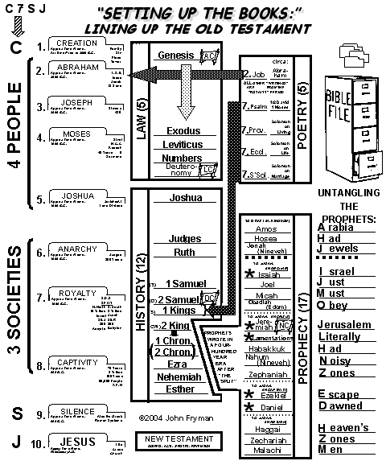
usrf;rsm;udk
pkpnf;xm;aom
tpDpOfwusxm;&SdNcif;
tpOfvdkufNzpfaom
"r®a[mif;usrf;
39 usrf;
taBumif;&if;rsm;
qufEG,frIrsm;
vufcHtwnfNyKNcif;
usrf;pmumvcefYrSef;aNc? tmNA[HrwdkifrSdrS bDpD 430 xd
pum;tquftpyf
oifaxmuful trSwf -34
8
84

Slide 85
Burmese
or®musrf;pm
tkwfNrpf
Texas jrdk.rS or®musrf;pm-tkwfjrpf (edkifiHwumtrSkawmfaqmifvkyfief;)\ wifjycsuf
www.biblebasically.org

Slide 86


တရားေဟာျခင္းအ တတ္ပညာ • BibleStudyDownloads.org
အခမဲ့အဘို့ဤတင်ပြချက်
Notes:
Preaching (pr)
Homiletics

Slide 87
Black

